Slide 1
Year 2 Statutory Assessment
Portishead Primary School
May 2020

Slide 2
Aims
To understand how the SATs are administered
Examples of what is assessed
What does the National Standard, Working Towards and Greater Depth look like?
How you can help
Questions

Slide 3
What are SATs?
Year 2 have to complete Statutory Assessments in Writing, Reading and Maths.
The results of these are reported to the chosen moderation team and are recorded nationally.

Slide 4
The Tests
There are 2 maths papers and 2 reading papers
They are administered under test conditions
They are completed throughout May so please ensure your child is in school
Not all children will sit them at the same time or in the same room

Slide 5
Maths
Paper 1 – Arithmetic 20 mins
Paper 2 – Reasoning 35 mins

Slide 6
Working Towards the standard
Count in 2s, 5s and 10s
Read and write numbers to 100
Value of coins
Partitioning of numbers into tens and ones
Know some of their number bonds to 10
Know their shapes
(Please be aware that this is not the complete list)

Slide 7
To be at the National Standard
Adding two 2-digit numbers, including crossing tens such as 36 + 27.
Read the time to the nearest 15 minutes.
Know multiplication and division facts for 2, 5, 10.
Subtract a 2-digit number from another 2-digit number, again including crossing tens such as 62 – 28.
(Please be aware that this is not the complete list )

Slide 8
Working at Greater Depth
Know the time to 5-minute intervals
Reasoning to solve complex problems
2 step problems
Describe similarities and difference of shapes.
(Please be aware that this is not the complete list )

Slide 9
Reading
Paper 1 – texts and questions combined – 30 mins
Paper 2 – More challenging texts with questions in a separate booklet – 40 mins

Slide 10
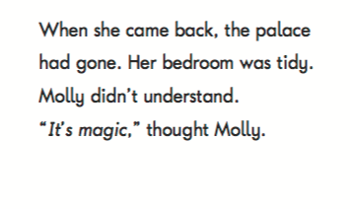
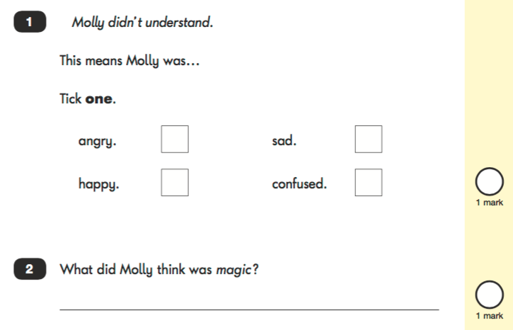
2017 SAT paper

Slide 11

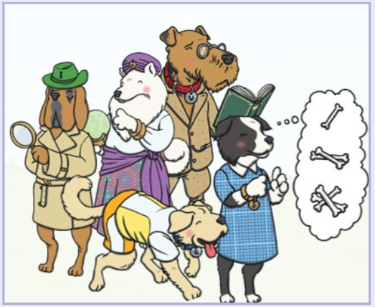
Comprehension in KS1
‘Helping Hounds’
Vocabulary Victor
Inference Iggy
Predicting Pip
Retrieval Rex
Sequencing Suki
‘Fluency Flo’
Notes:
Janet

Slide 12
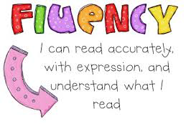
Reading fluency
Decoding quickly and automatically- not having to stop at words to sound out
Reading with speed, accuracy and expression. In order to understand what they read, children need to read fluently.
Bridges a gap between word recognition and comprehension.
Taught daily to groups across the school until children are fluent readers

Slide 13
Reading support in school
Spelling groups daily – supports writing
Comprehension weekly in whole class sessions (Reading dogs/helping hounds)
Guided reading fluency groups daily
Parent helpers needed….
Notes:
Ky? In years 1, 2 and 3, as well as the teaching of phonics and spelling, there is also a focus on comprehension and reading for enjoyment. We use a ‘Book Band’ scheme which is carefully graded to move the readers rapidly at first, then more slowly; using one small step at a time. In addition to that, ‘Guided Reading’ takes place in classes daily; through a carousel of reading activities to further develop word recognition and fluency skills. Each class has a weekly comprehension lesson, where children are encouraged to ask and answer questions about the text, using our ‘Reading Dogs/Helping Hounds’.

Slide 14
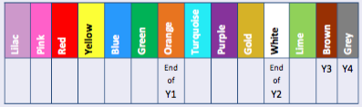
All children reading Book bands
Not a race or a competition!
Moving slowly to ensure children are fluent and have appropriate comprehension skills.
Home reading books at 95-100% accuracy to develop fluency. 90 words per minute pace.
Notes:
Sam

Slide 15


Slide 16
Working Towards the standard
With support answer questions and make inferences.
Read many common exception words.
Accurately blend common graphemes.
Read aloud many words quickly and accurately without overt sounding and blending.
(Please be aware that this is not the complete list )

Slide 17
To be at the National Standard
No set book band level. However children who are at the expected standard are usually reading white band and above.
Read fluently and accurately without too much sounding and blending (around 90 words per minute).
Check it makes sense.
Read most common exception words.
Answer questions and make some inferences.
(Please be aware that this is not the complete list )

Slide 18
Working at Greater Depth
Make links between the books they are reading and other books.
Predict what might happen next based on what has happened so far.
Make inferences.
(Please be aware that this is not the complete list )

Slide 19
SPAG
Not statutory to sit tests but the children will do in Term 6.
Tests children’s knowledge and understand of spelling, punctuation and grammar.
The children are used to these types of questions.

Slide 20
Writing
No formal tests.
All teacher assessment based on classwork and independent writing tasks.

Slide 21
Working Towards the standard
Using full stops and capitals in some sentences
Spelling some common exception words
Form letters in the correct direction
Use spaces between words
Use their phonics to spell words
(Please be aware that this is not the complete list )

Slide 22
To be at the National Standard
Accurate punctuation for most sentences – CL . ?
Consistent use of the correct tense
Using co-ordination (but or and) and some subordination (when if that because) to join clauses
Spelling many common exception words accurately
Forming letters of correct size – CL and long ladders taller, the rest half line size.
(Please be aware that this is not the complete list )

Slide 23
Working at Greater Depth
Using the full range of punctuation mostly accurately ! . ?, Commas in a list and ’ apostrophes for possession and contractions
Using some joins in their handwriting
Spelling most common exception words
Suffixes to spell most words correctly (-ment –ness –ful –less –ly)
Make additions, revisions and proof-reading corrections to their own writing
Vocabulary – interesting word choices, upscaling using a thesaurus
(Please be aware that this is not the complete list )

Slide 24
Teacher Responsibilities
To use the test scores and classroom work to make a judgement.
It is not best fit. All the attainment targets have to be met.
Each child to be given a result for Maths, Reading, Writing and Science.

Slide 25
How you can help
Don’t worry about the SATs at home or label them as tests - just always encourage your child to do their best.
Practise key skills :
2s, 5s, 10s times tables and bonds to 10/20 eg 3+7=10 so 10-7=3 and therefore 13+7=20 so 20-7=13
Telling the time quarter to /past (Expected) 5 minute intervals (Greater Depth only)
Spelling sight words and suffixes –ed –ing –er -est –ment
–ness –ly -ful
Regular reading for fluency https://www.oxfordowl.co.uk/for-home/find-a-book/library-page/ https://www.teachyourmonstertoread.com
Complete comprehension papers set for HW with your child (encourage independence first)

Slide 26
Reporting
In your child’s report you will be told if your child has met the expected standard, is working towards the standard or is working at Greater Depth for the end of Key Stage 1.
Some children may be assessed using the pre–key stage 1 standards.
There will be a result for each curriculum area as discussed.
We will be practising past SATs papers in class in Terms 3 and 4.

Slide 27

Questions…

