Slide 1


at Portishead Primary School
This morning will provide a general overview of SEND at PPS
Personalised Provision –
Class Teacher/ SENDCo
Community
Confidentiality
Respect
‘Navigating the SEND system is not a positive experience for children, young people and their families.’ March 2022 Review

Slide 2
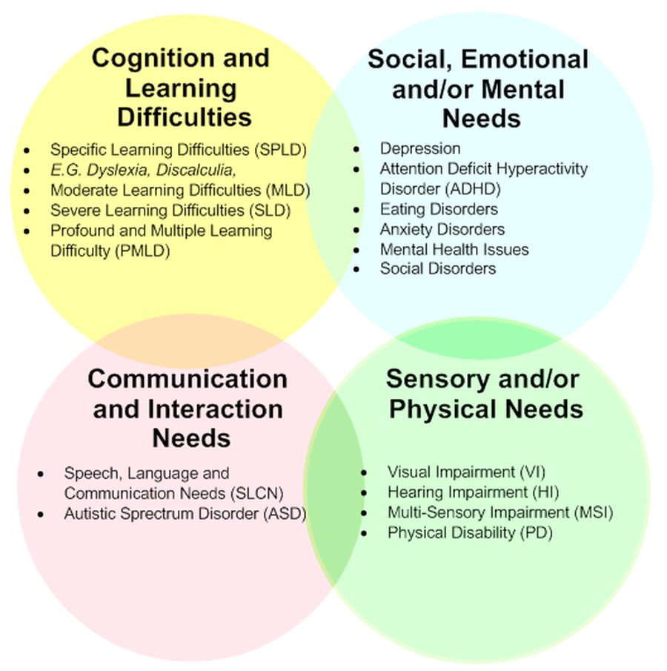

4 Areas of SEND

Slide 3
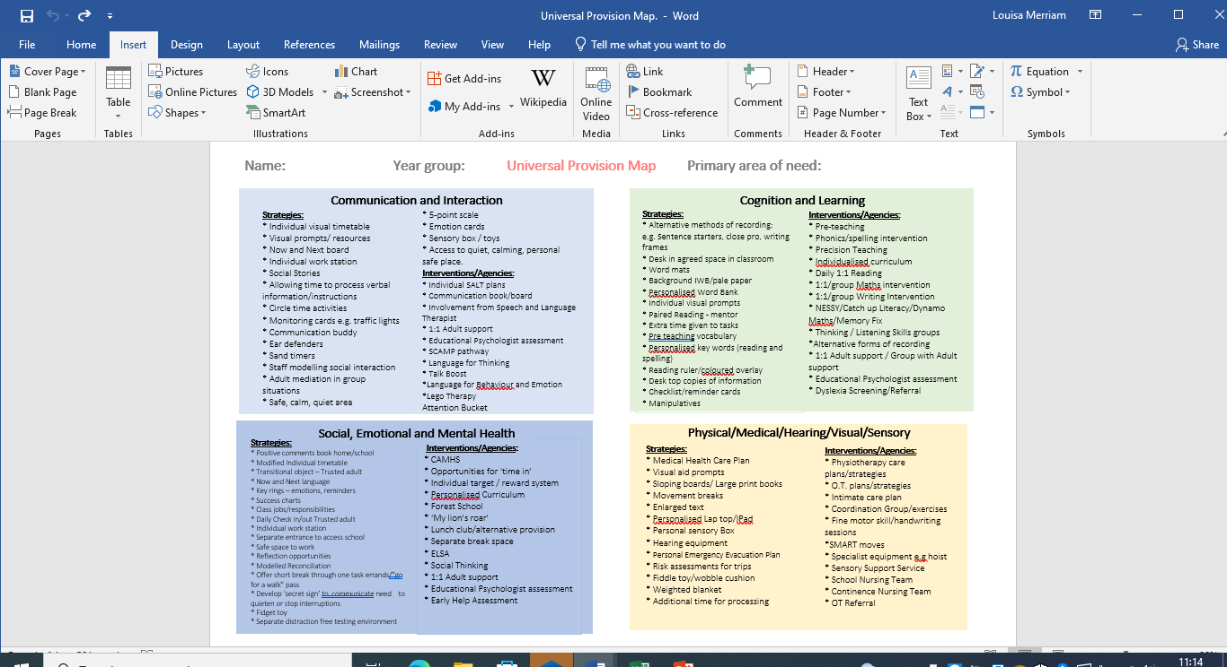
Universal Provision at Portishead Primary School

Slide 4
Communication and Interaction
Strategies:
* Individual visual timetable
* Visual prompts/ resources
* Now and Next board
* Individual work station
* Social Stories
* Allowing time to process verbal information/instructions
* Circle time activities
* Monitoring cards e.g. traffic lights
* Communication buddy
* Ear defenders
* Sand timers
* Staff modelling social interaction
* Adult mediation in group situations
* Safe, calm, quiet area
* 5-point scale
* Emotion cards
* Sensory box / toys
* Access to quiet, calming, personal safe place.
Interventions/Agencies:
* Individual SALT plans
* Communication book/board
* Involvement from Speech and Language Therapist
* 1:1 Adult support
* Educational Psychologist assessment
* SCAMP pathway
* Language for Thinking
* Talk Boost
*Language for Behaviour and Emotion
*Lego Therapy
Attention Bucket

Slide 5
Cognition and Learning
Strategies:
* Alternative methods of recording:
e.g. Sentence starters, close pro, writing frames
* Desk in agreed space in classroom
* Word mats
* Background IWB/pale paper
* Personalised Word Bank
* Individual visual prompts
* Paired Reading - mentor
* Extra time given to tasks
* Pre teaching vocabulary
* Personalised key words (reading and spelling)
* Reading ruler/coloured overlay
* Desk top copies of information
* Checklist/reminder cards
* Manipulatives
Interventions/Agencies:
* Pre-teaching
* Phonics/spelling intervention
* Precision Teaching
* Individualised curriculum
* Daily 1:1 Reading
* 1:1/group Maths intervention
* 1:1/group Writing Intervention
* NESSY/Catch up Literacy/Dynamo Maths/Memory Fix
* Thinking / Listening Skills groups
*Alternative forms of recording
* 1:1 Adult support / Group with Adult support
* Educational Psychologist assessment
* Dyslexia Screening/Referral

Slide 6
Social, Emotional and Mental Health
Strategies:
* Positive comments book home/school
* Modified Individual timetable
* Transitional object – Trusted adult
* Now and Next language
* Key rings – emotions, reminders
* Success charts
* Class jobs/responsibilities
* Daily Check in/out Trusted adult
* Individual work station
* Separate entrance to access school
* Safe space to work
* Reflection opportunities
* Modelled Reconciliation
* Offer short break through one task errands/”go for a walk” pass
* Develop ‘secret sign’ to communicate need to quieten or stop interruptions
* Fidget toy
* Separate distraction free testing environment
Interventions/Agencies:
* CAMHS
* Opportunities for ‘time in’
* Individual target / reward system
* Personalised Curriculum
* Forest School
* ‘My lion’s roar’
* Lunch club/alternative provision
* Separate break space
* ELSA
* Social Thinking
* 1:1 Adult support
* Educational Psychologist assessment
* Early Help Assessment

Slide 7
Physical/Medical/Hearing/Visual/Sensory
Strategies:
* Medical Health Care Plan
* Visual aid prompts
* Sloping boards/ Large print books
* Movement breaks
* Enlarged text
* Personalised Lap top/IPad
* Personal sensory Box
* Hearing equipment
* Personal Emergency Evacuation Plan
* Risk assessments for trips
* Fiddle toy/wobble cushion
* Weighted blanket
* Additional time for processing
Interventions/Agencies:
* Physiotherapy care plans/strategies
* O.T. plans/strategies
* Intimate care plan
* Coordination Group/exercises
* Fine motor skill/handwriting sessions
*SMART moves
* Specialist equipment e.g hoist
* Sensory Support Service
* School Nursing Team
* Continence Nursing Team
* OT Referral

Slide 8

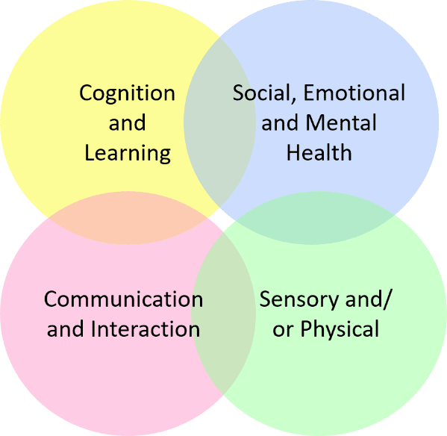
at Portishead Primary School
Language for Behaviour
and Emotion
Language for Thinking
Lego Therapy
Touch Typing
Beat Dyslexia
Dynamo Maths
Pre Teaching
Post Teaching
Memory Fix
Smart Moves
Catch up Literacy
2/3 4/5 6/1

Slide 9


at Portishead Primary School
North Somerset Single Point of Entry
- Community Paediatricians
- Speech and Language
- Physiotherapy
- Occupational Therapy
-CAHMs
Dyslexia/ Dyscalculia Screeners and Assessments
Early Help/Parent Support Group
School Speech and Language
North Somerset SEND Team
School Educational Psychologist
EHCP Referral for Assessment

Slide 10

Supporting your children at home…
Things might look different – and that’s OK!
Use alternative methods of recording
Routines and Rewards
Draw attention to behaviours that you want to see
Separate Behaviour from Children
Sanctuary
Reach out
Read Read Read!

Slide 11


