Slide 1

Spelling, Punctuation and Grammar
Parent Workshop
Overview:
Spelling @ PPS
End of Key Stage writing expectations
Common misconceptions and difficulties
Resources and places to go for help
Marie Barrett and Dave Sprake
(English Leaders)

Slide 2
English
Reading
Writing
Spoken Language
Spelling, Punctuation and Grammar
Notes:
English consists of these 3 main pillars of Reading, Writing and Spoken Language and all of our English lessons in school consist of 1 or more of these elements. Spelling, Punctuation and Grammar is the thread that’s interwoven between all of those and we shouldn’t think of it as a discrete subject that’s taught in isolation. A really sound understanding of Spelling, Punctuation and Grammar is crucial to overall success in English.

Slide 3
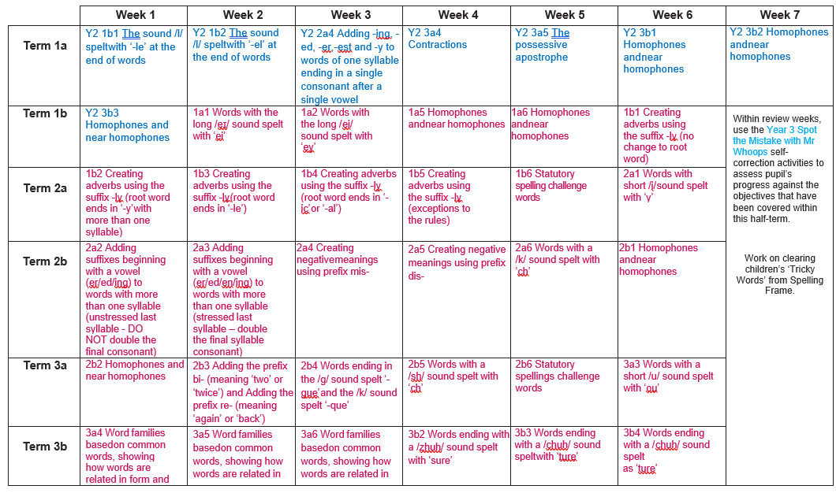
Spelling @ PPS
After Phase 5 phonics is secure (usually during Year 2)
Objectives ordered to review and consolidate previous years if necessary
Covers all National Curriculum rules and patterns, including statutory spellings.

Slide 4
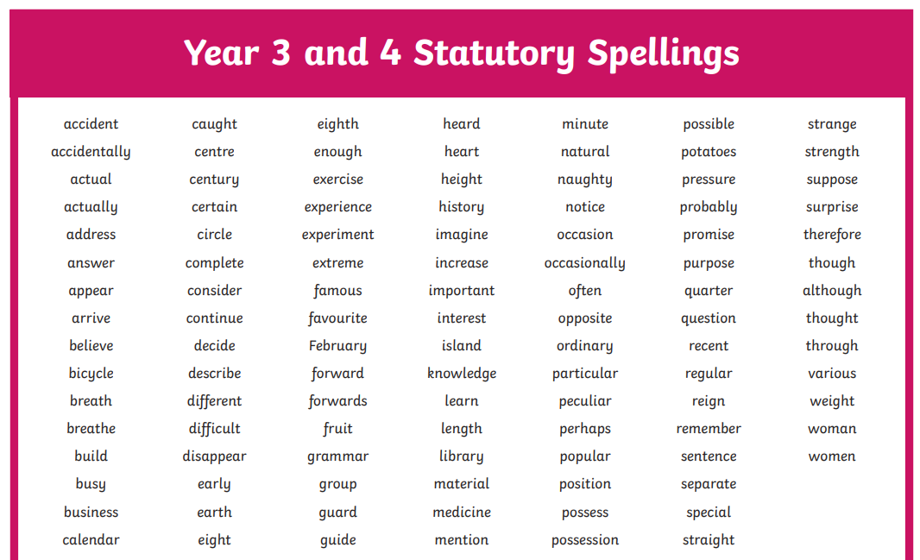
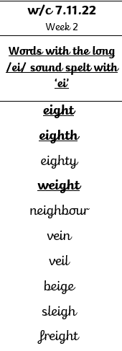
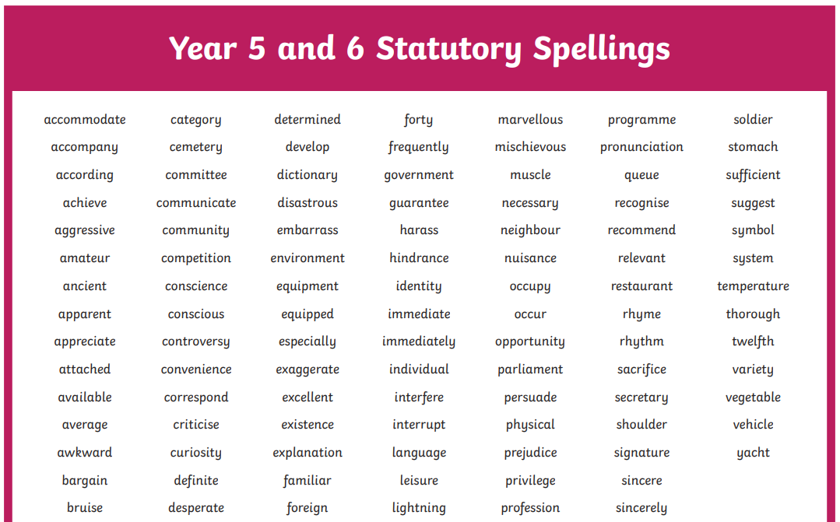
Spelling @ PPS
Statutory Spellings
Highlighted in weekly spellings

Slide 5
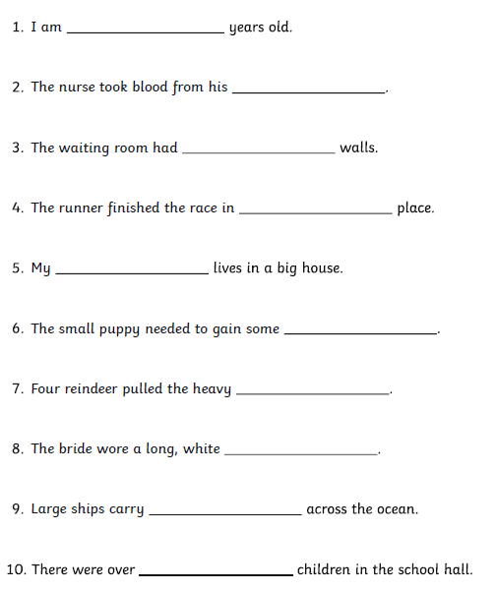
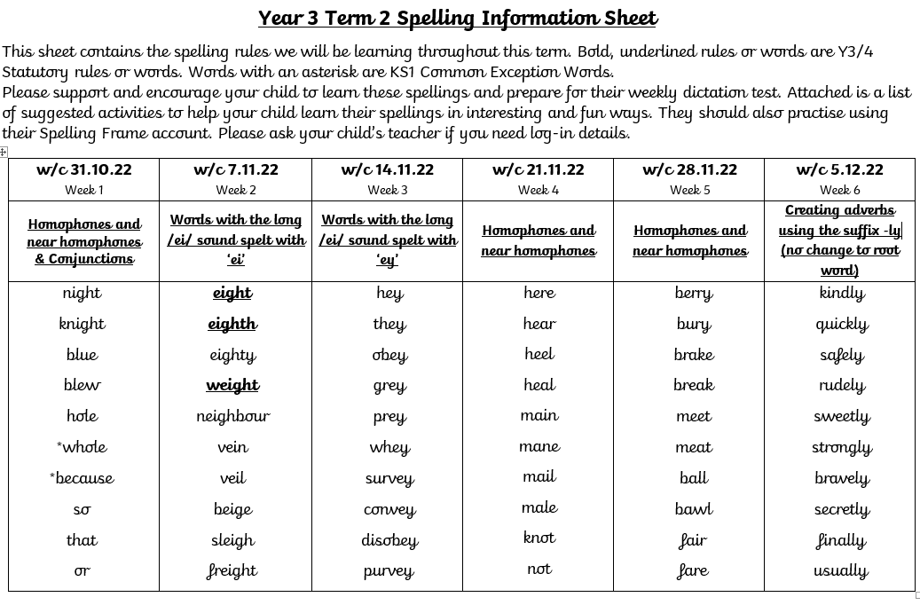
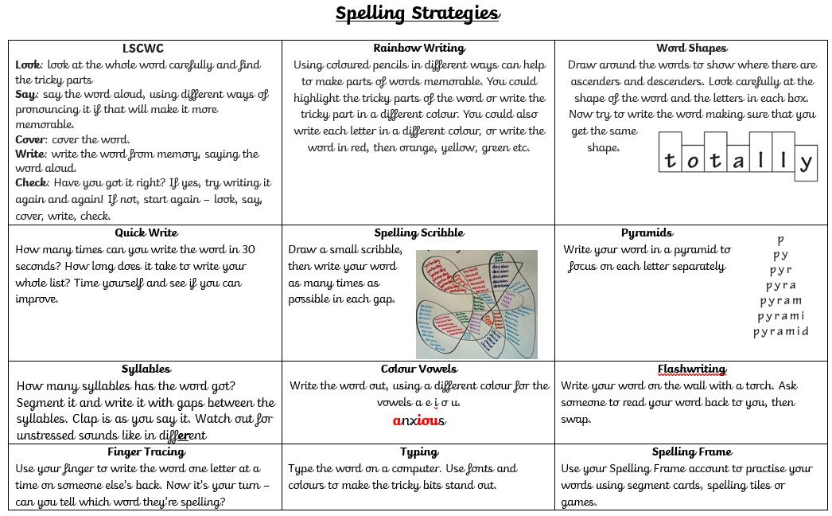
Spelling @ PPS
Each week’s rule or pattern is introduced and taught explicitly. Later that week or the next week, words are tested using a weekly dictation test.

Slide 6

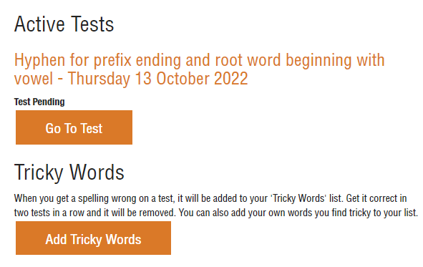
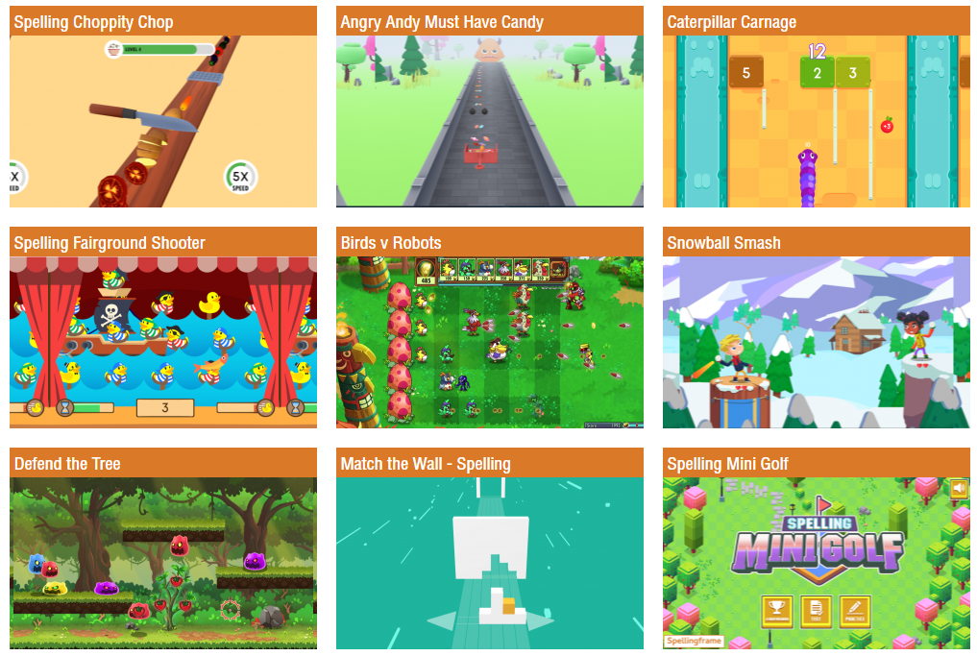
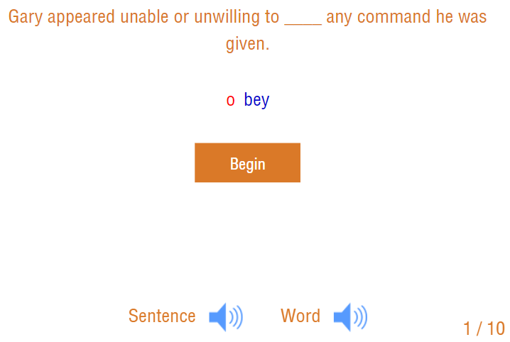
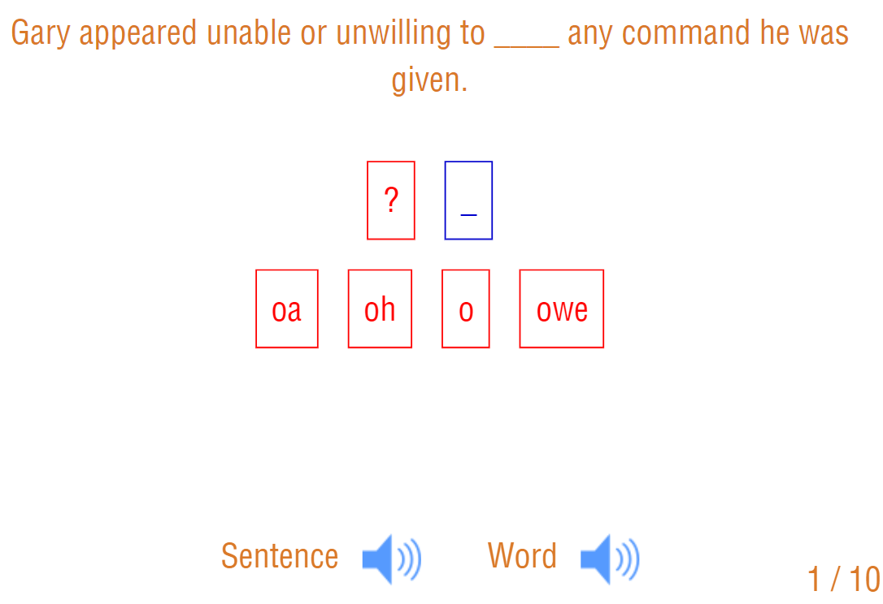
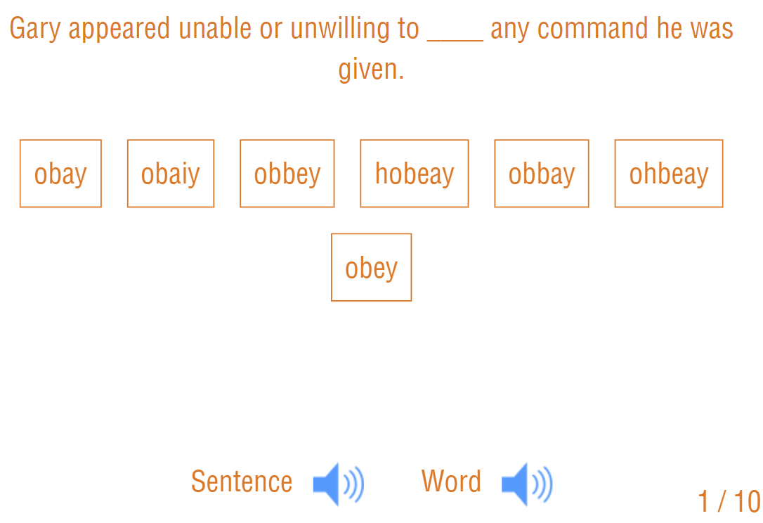
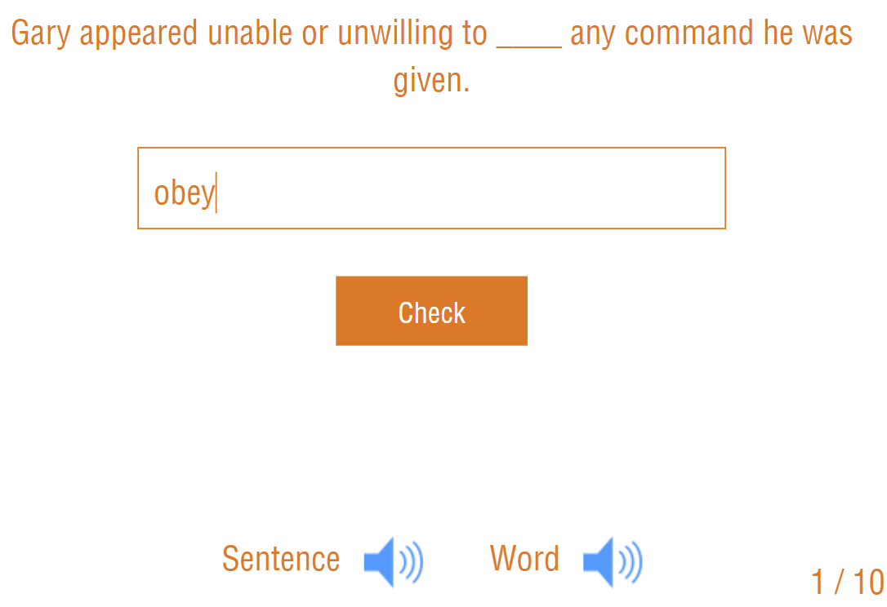
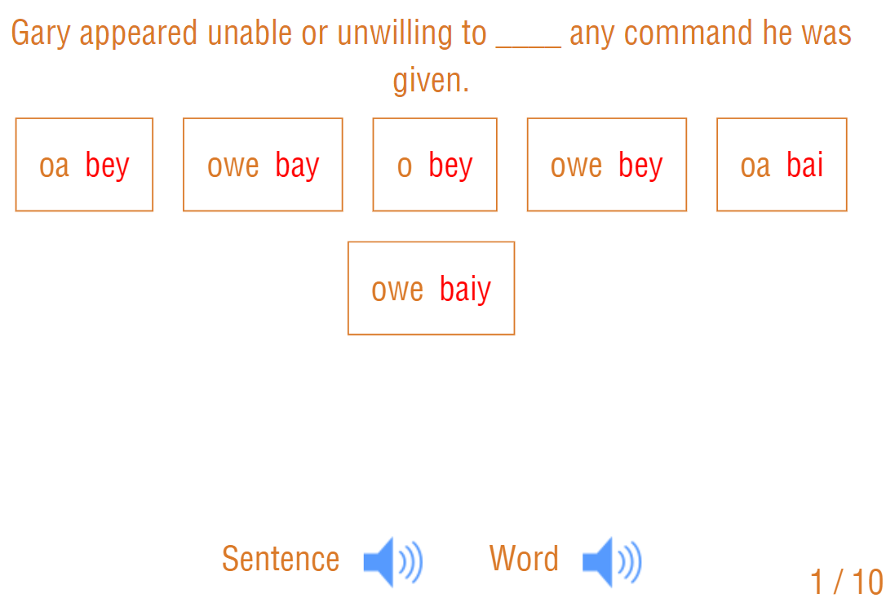
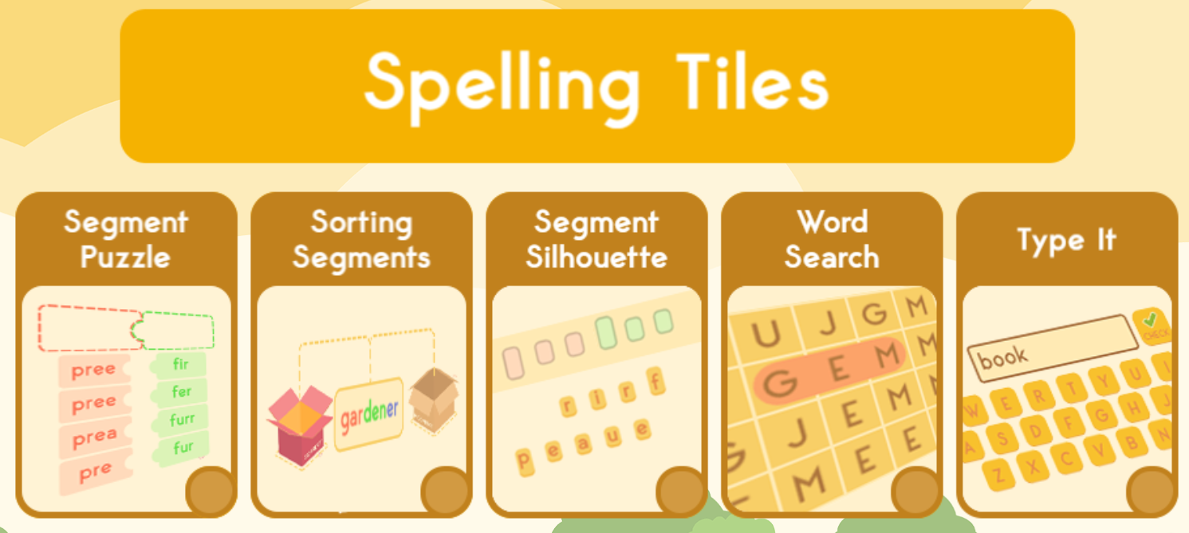
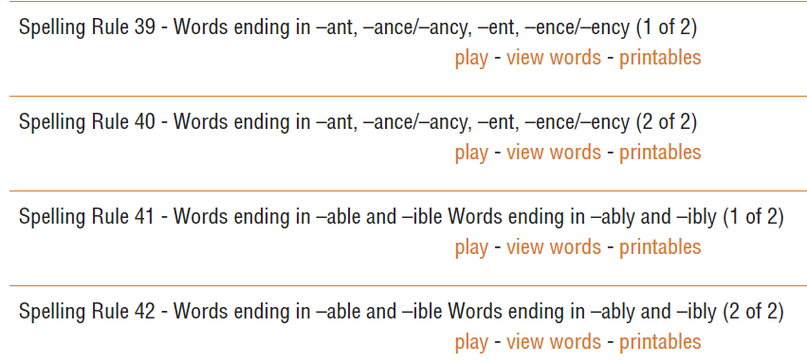
Focuses on segmenting and blending words so has good continuity with our phonics teaching
Words are put into context in ambitious sentences. This helps to build vocabulary.

Slide 7
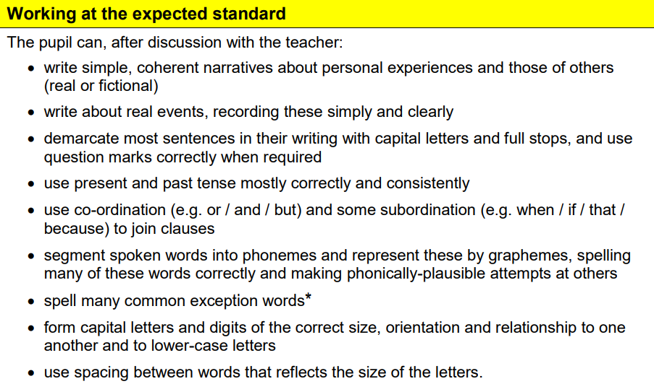
Writing Expectations – End of KS1

Slide 8
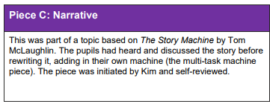
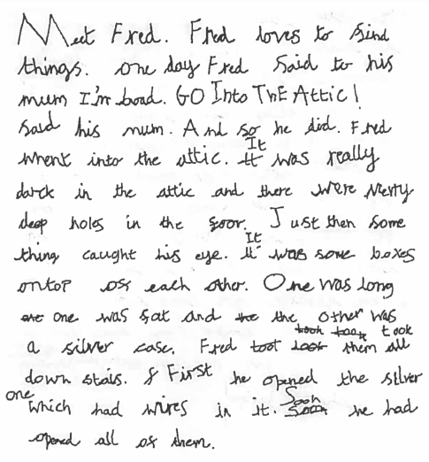
Adverbials show sequencing of events
Co-ordinating conjunction (and) joins main clauses correctly
Present, past and past perfect tenses help to establish the relationship between the events
Sentence demarcated with capital letters, full stops and exclamation marks

Slide 9
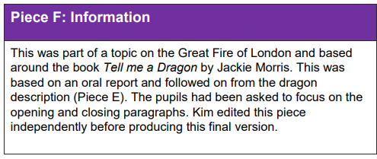
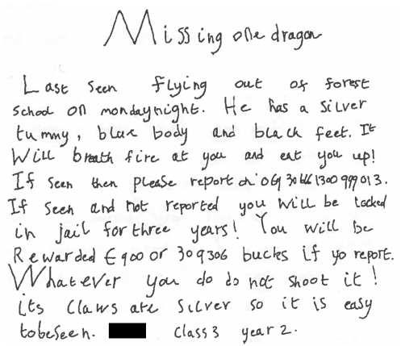
Expanded noun phrases highlight specific features
The passive voice creates a more formal tone
Subordinate clause alerts the reader to important information in the main clause
Letters are sized correctly and consistently and have appropriate spacing.

Slide 10
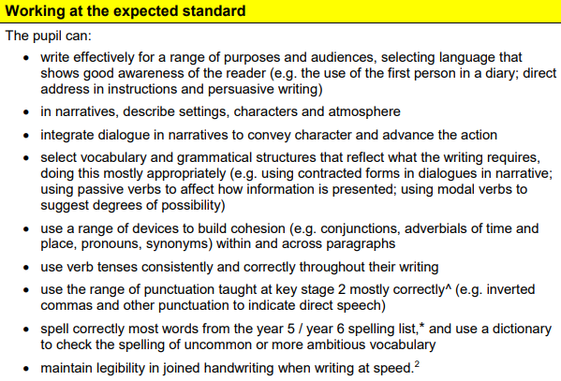
Writing Expectations – End of KS2

Slide 11
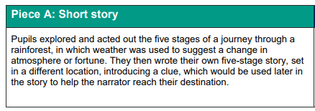
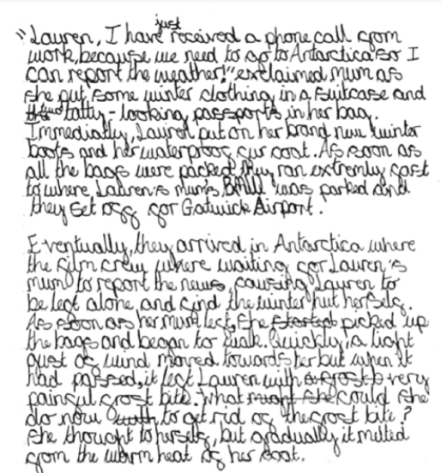
Correctly punctuated dialogue to establish the characters, setting and plot
Expanded noun phrases, including prepositions, convey detail concisely
Multi-clause sentence shows control of a range of subordinate clauses
Question shows awareness of the reader. Modal verb ‘could’ indicates possibility.

Slide 12
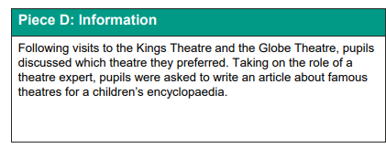
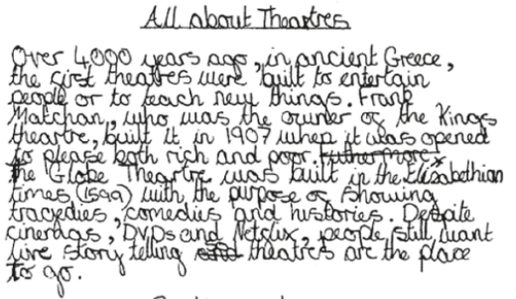
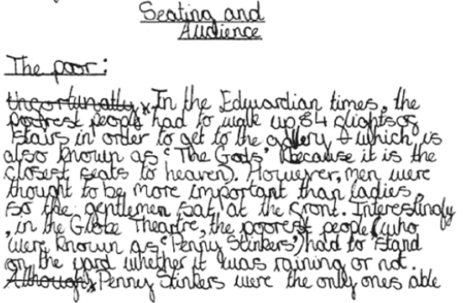
Preposition phrases add detail and indicate the relationship between past and present
Vocabulary choices convey an appropriately formal tone
Passive verbs also support formality
Handwriting is consistently sized and correctly joined. Spelling of most words is correct, including Year 5/6 statutory words, e.g. ancient

Slide 13
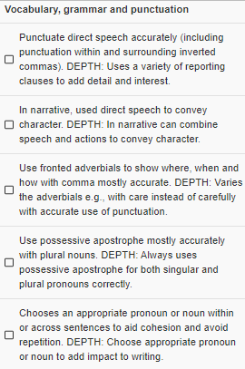
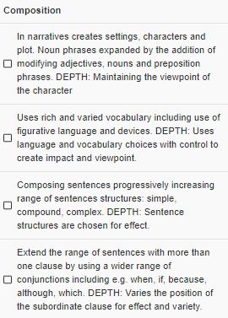
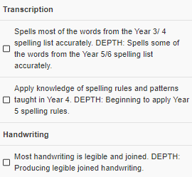
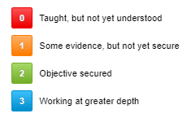
Assessment in other year groups
Notes:
That end of Key Stage assessment is most formal process, and our judgements are checked periodically by external moderators to ensure we’re being accurate and consistent.
Alongside this, we also use our KPIs or Key Performance Indicators to assess children’s progress in writing at set points throughout the year. Each year group has a set of objectives which their teacher can make 1 of 4 judgements against. This helps us to track progress in a much more detailed way and gives us more information about what children can do and where they need extra support.

Slide 14

Common Misconceptions and Difficulties

Slide 15
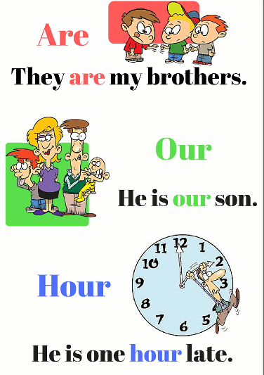


homophones
Words that sound the same but are spelled differently
Try to point these out when reading together and correct mistakes when children write.

Slide 16
Tense and tense agreement
Year 2 – use the present and past tenses including the progressive form
Year 3 – use the present perfect form of verbs in contrast to the past tense
Year 6 – use the perfect form of verbs to mark relationships of time and cause
 | Past | Present
Simple | I ran | I run
Progressive | I was running | I am running
Past simple | I ran
Past progressive | I was running
Present perfect | I have run
 | Past | Present
Simple | I ran | I run
Progressive | I was running | I am running
Perfect | I had run | I have run

Slide 17
Tense and tense agreement
Children sometimes struggle to remember irregular verb forms
“I runned”
or to match the verb form with the tense
“I had ran”
or invent their own conjugations
“I writ”
 | Past | Present
Simple | I ran | I run
Progressive | I was running | I am running
Perfect | I had run | I have run
This is a really big part of using
‘Standard English’.
Try to model using correct tenses in speech and gently correct children when they use an incorrect verb form.

Slide 18
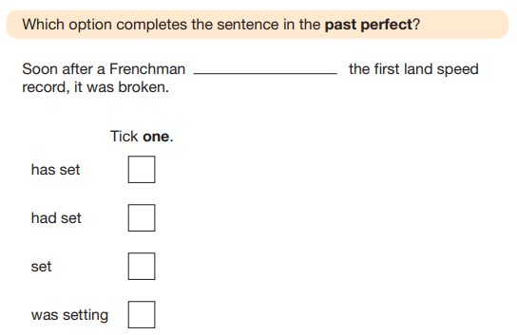
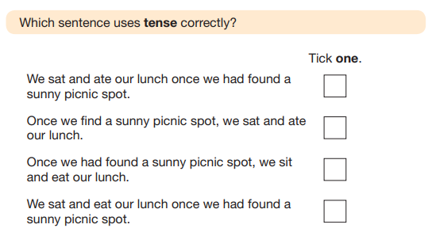
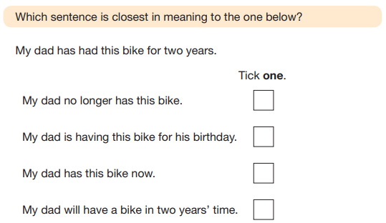
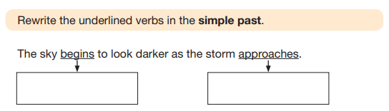
Tense and tense agreement
✓
✓
began
approached
✓

Slide 19
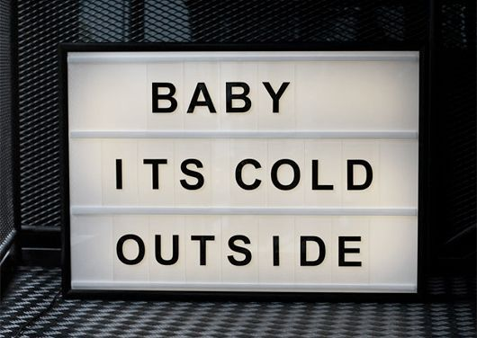
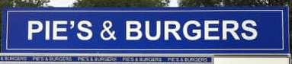
apostrophes
2 purposes:
Omission (where letters are missed because 2 or more words have been used to form a contraction)
Possession (to show ownership)
SAT’s
,

Slide 20
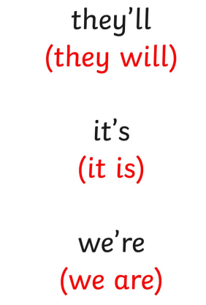
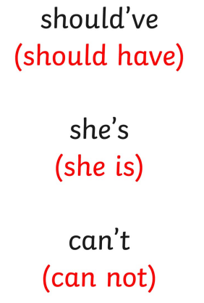
Apostrophes for omission
should of
it’s = it is
its = belongs to it

Slide 21

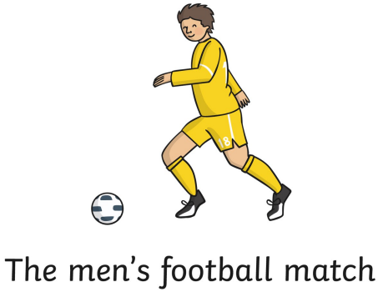
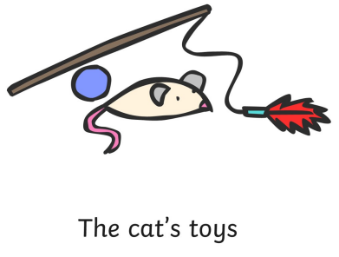
Apostrophes for possession
Singular possession
Plural possession
Irregular plural possession
Instead of worrying about ‘before or after the s’,
remember that the apostrophe always comes after the owner or owners.

Slide 22
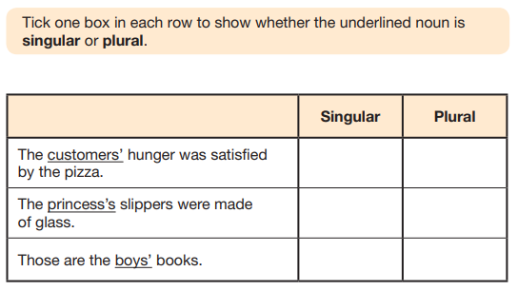
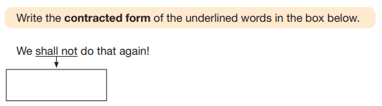
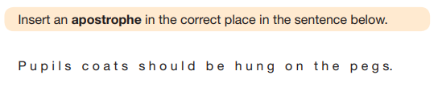
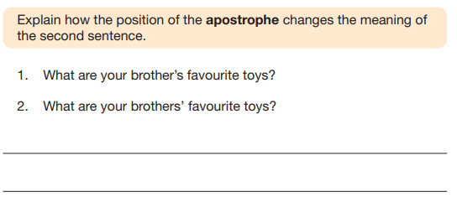
apostrophes
shan’t
✓
✓
,
✓
The first is about 1 brother (singular)
The second is about more than 1 brother (plural)

Slide 23
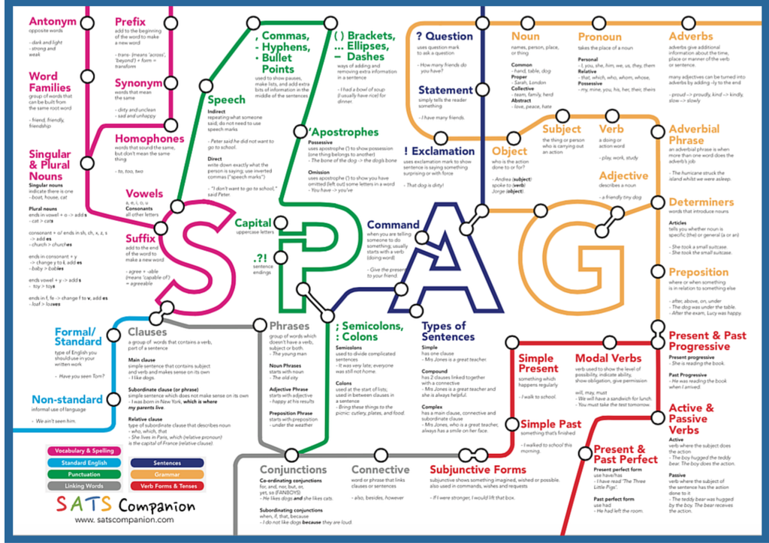

Slide 24
How to support Spelling, Punctuation and Grammar at home
Look at and talk about punctuation when you read.
Encourage them to use correct punctuation when writing sentences in homework or other activities they choose to do.
Encourage punctuation use even if using a word processing program.
Encourage them to use the correct speech.
‘I done it’ ‘ We was going’ ‘sleeped’ ‘breaked’ ‘digged’ ‘eated’ ‘drinked’ ‘throwed’ ‘writed’
Try repeating what they say using the correct word or tense.

Slide 25
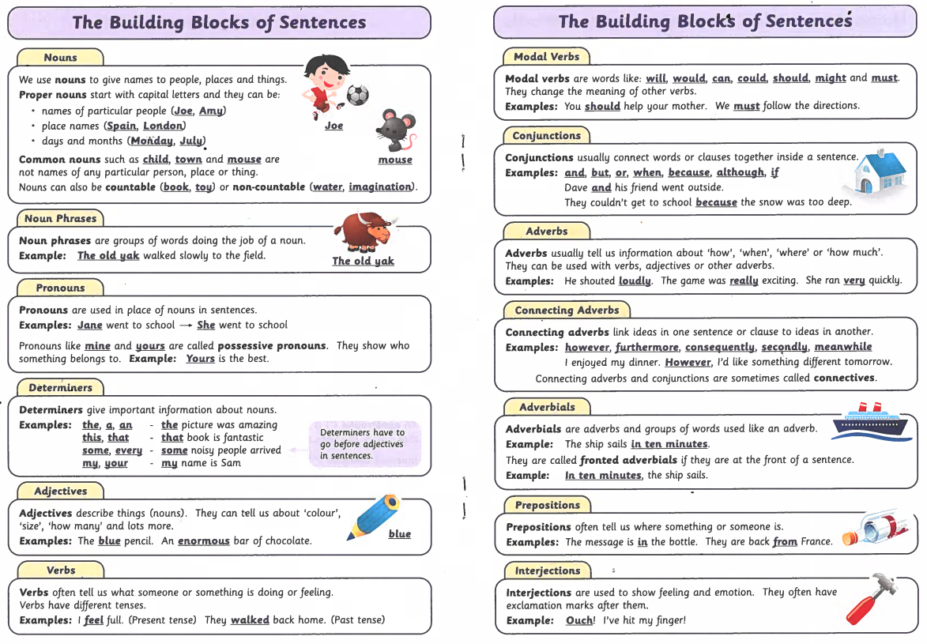
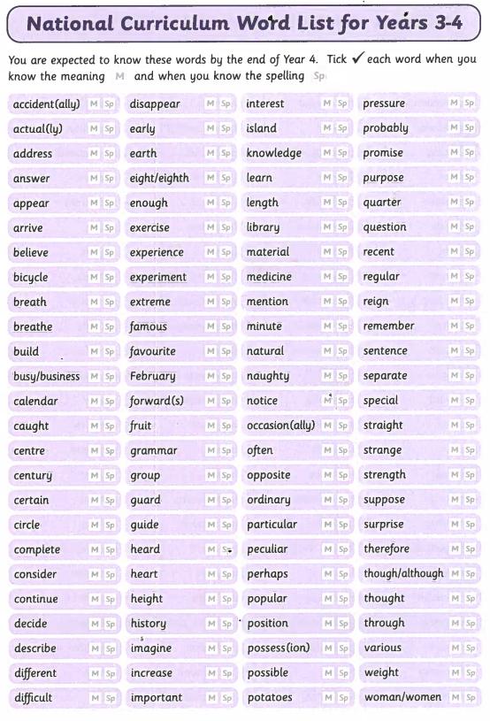
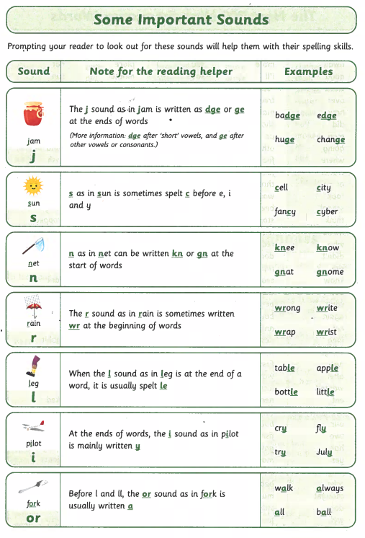





Resources and where to go for help
Middle of Reading Records

Slide 26




Resources and where to go for help
CGP books
Grammar dictionaries

Slide 27
Useful websites
Your Dictionary https://grammar.yourdictionary.com/homework-help.html
Grammar Monster https://www.grammar-monster.com/grammar_terms_and_definitions.htm
The School Run https://www.theschoolrun.com/grammar-primary-school
BBC Bitesize https://www.bbc.co.uk/bitesize/topics/zhrrd2p
National Curriculum glossary https://assets.publishing.service.gov.uk/government/uploads/system/uploads/attachment_data/file/244216/English_Glossary.pdf
YouTube
  Anchor Creative Education
  Grammarsaurus
  BBC Teach

Slide 28

Any Questions?

