Slide 1

Reading for Pleasure
Parent Workshop
Overview:
Reading is key
How we teach reading skills at PPS
Importance of ‘Reading for Pleasure’
How families can support
Marie Barrett (English Leader)

Slide 2

Reading is key
Reading underpins all other areas of the curriculum
Department for Education’s ‘The Reading Framework, 2022’ states:
  “The reading and writing of Standard English, alongside proficient language development, is the key to unlocking the rest of the academic curriculum. Pupils who struggle to read struggle in all subjects and the wonders of a knowledge-rich curriculum passes them by unread. Fluency of reading is also a key indicator for future success in further education, higher education and employment.”
  Evidence also indicates that poor literacy skills put children at greater risk of poorer health, criminal offending, poor emotional and psychological well-being and overall life satisfaction.

Slide 3






How we teach reading at Portishead Primary
Word Recognition (Decoding) | Comprehension
Systematic phonics (EYFS/KS1) 1:1 and small group reading (EYFS/KS1) | Shared stories and books 1:1 and small group reading (EYFS/KS1) Whole class guided reading (KS2)
Being able to decode does not mean you understand what you read.
A child can sound like a ‘good reader’ but not necessarily understand what the text means.

Slide 4
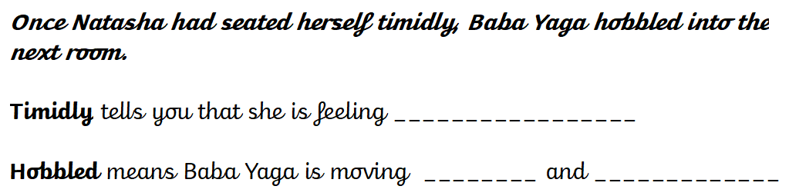
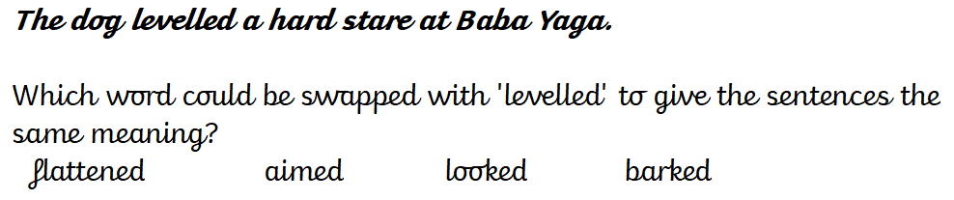
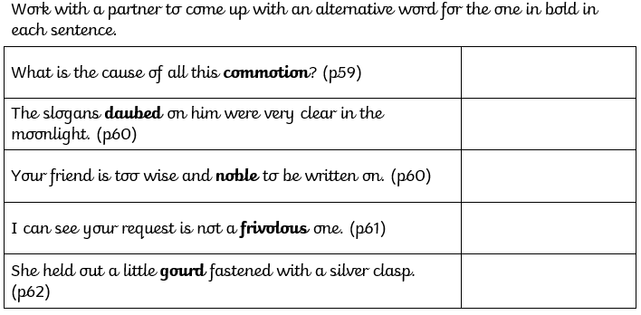


Slide 5
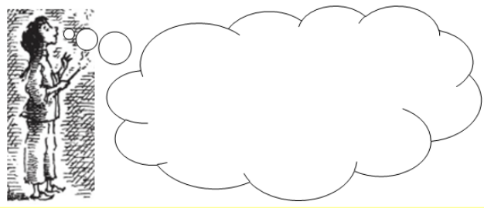
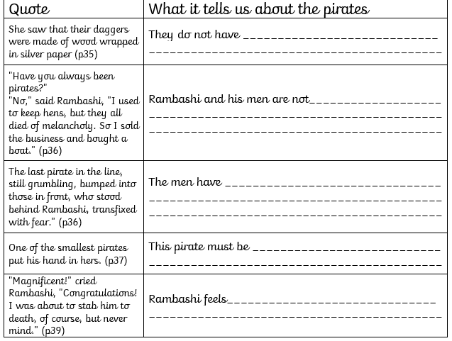
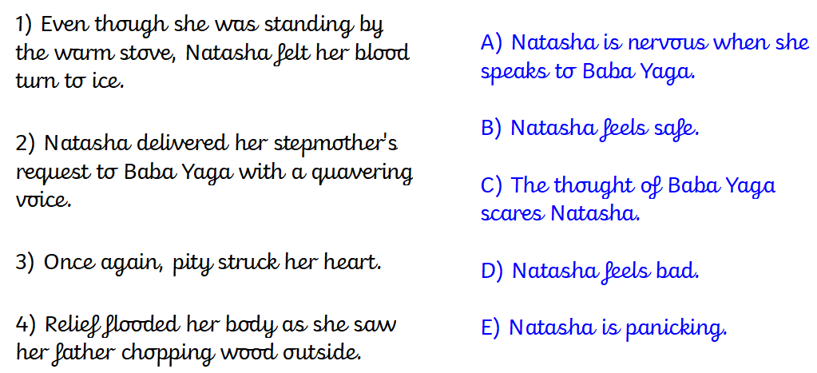
How do you think the author felt about Victorian children? What tells you this?

Slide 6
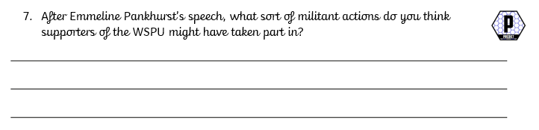

Do you think he will enter the cave?
YES NO
Give a reason based on what has happened so far.

Slide 7
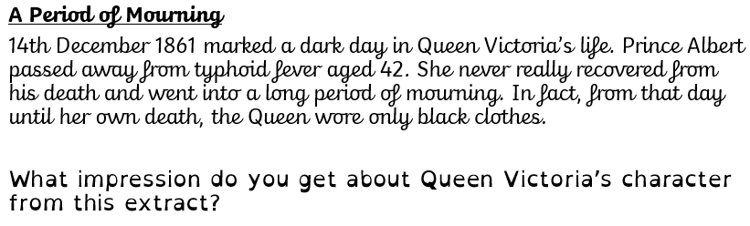
How does writer build suspense in this paragraph?
Which was the most exciting part? Why?

Slide 8
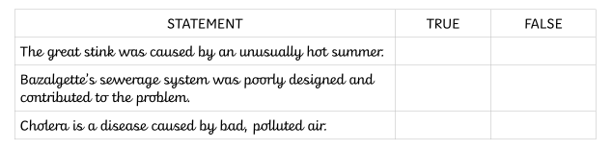
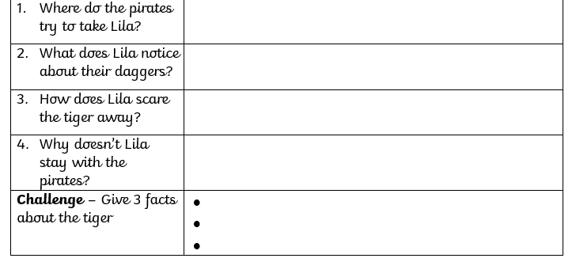
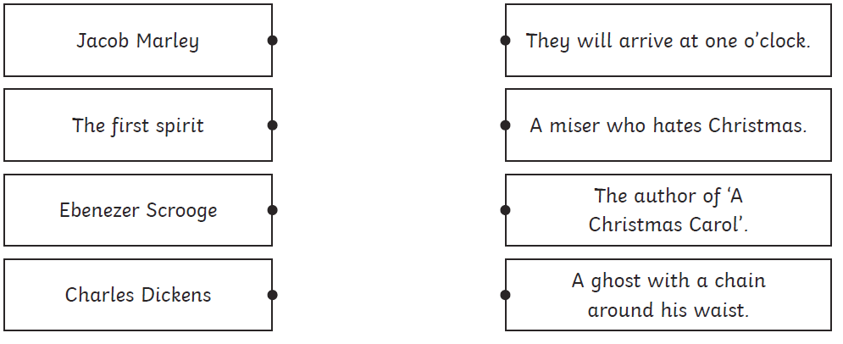
Skimming – reading quickly through an extract to take in the whole thing
e.g. On p33, who talks the most times?
Scanning – skipping through an extract to look for a particular word/phrase
e.g. Find the date Queen Victoria was born.

Slide 9
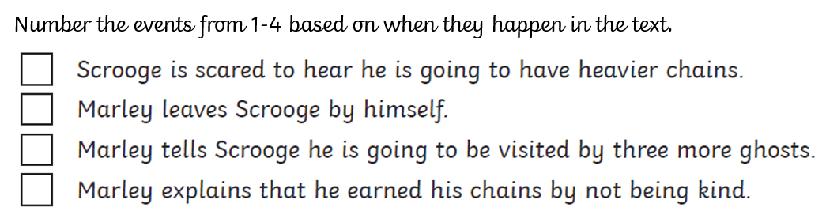
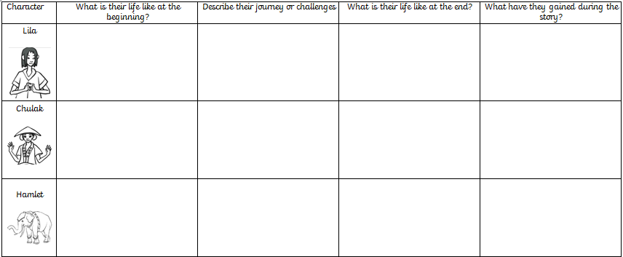
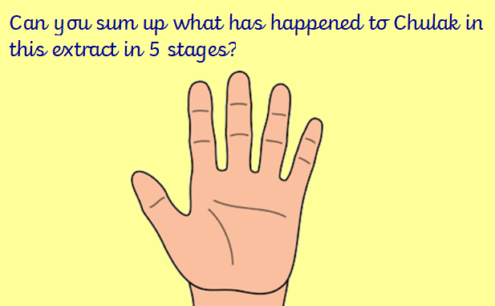

Slide 10
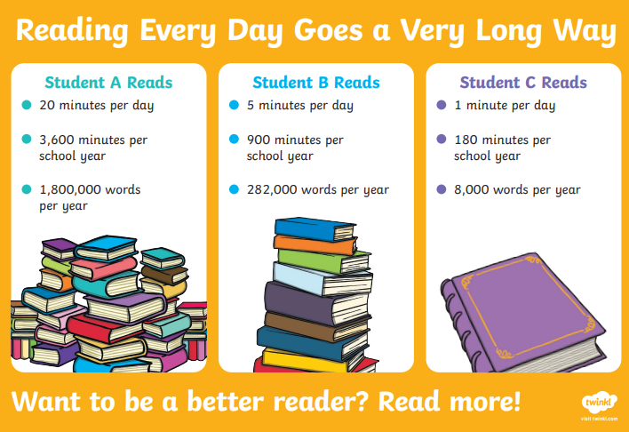
Reading is a skill. We can teach it in a classroom, but it must be practiced to become fluent.
Data consistently shows that engagement in reading is strongly correlated with reading performance (PISA 2021)
Children will not practice reading unless it is accessible, available
and enjoyable.
Reading for Pleasure is now a part of the National Curriculum and schools are currently investing heavily in this area.

Slide 11
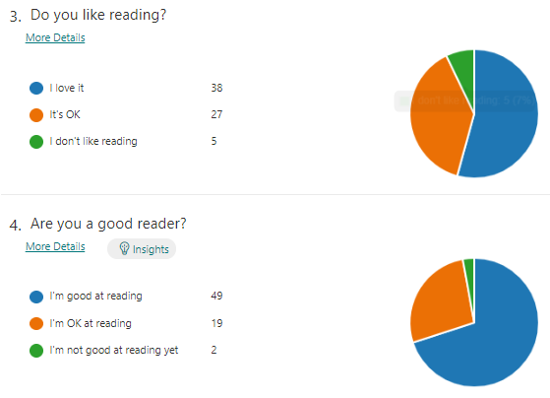
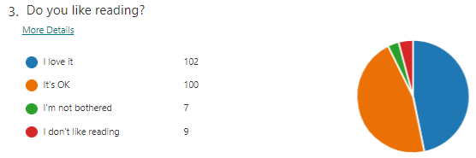
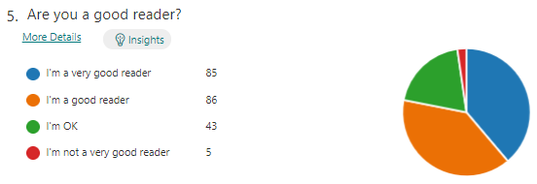
KS1
Reading for Pleasure – the current picture
Children’s attitudes to reading in England are comparatively low compared to their skills (PIRLS 2016) and are in a downward trend (National Literacy Trust)
At PPS, our children’s attitudes to reading are generally positive, but decline as they get older.
40% KS1 and 46% KS2 say no-one reads to them at home
31% KS2 say they don’t read with anyone else at home
KS2

Slide 12
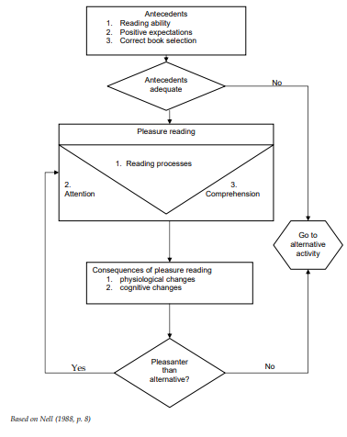

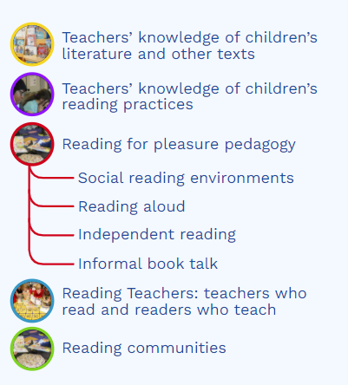
Reading for Pleasure
- our work at PPS

Slide 13
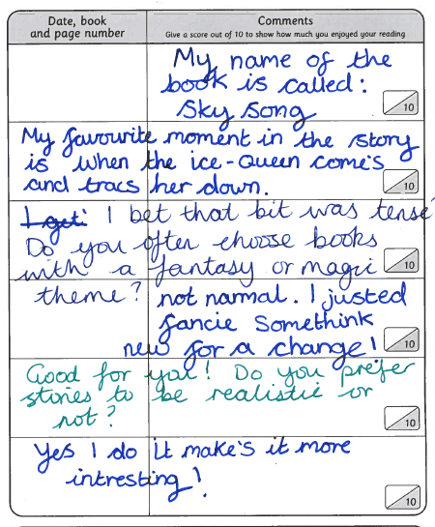
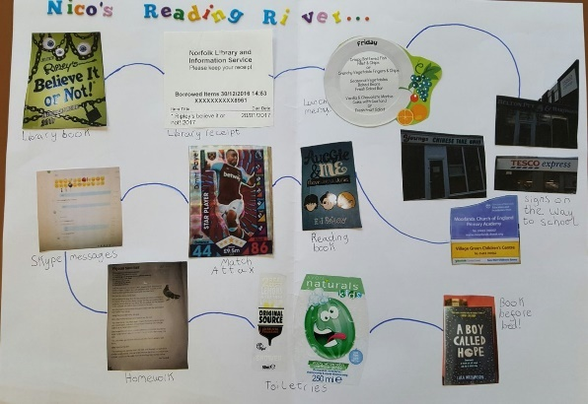
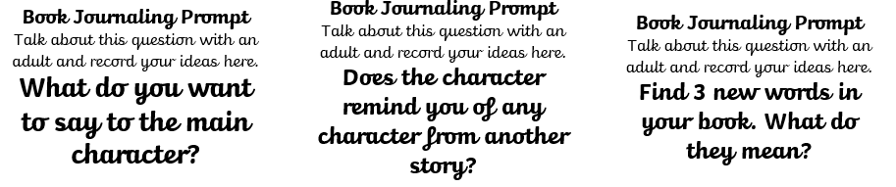
Reading Surveys
Reading Rivers
Book Journaling
2 minute book club

Slide 14
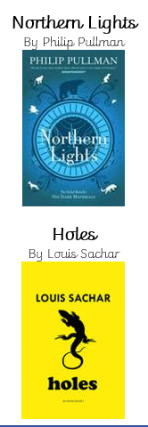
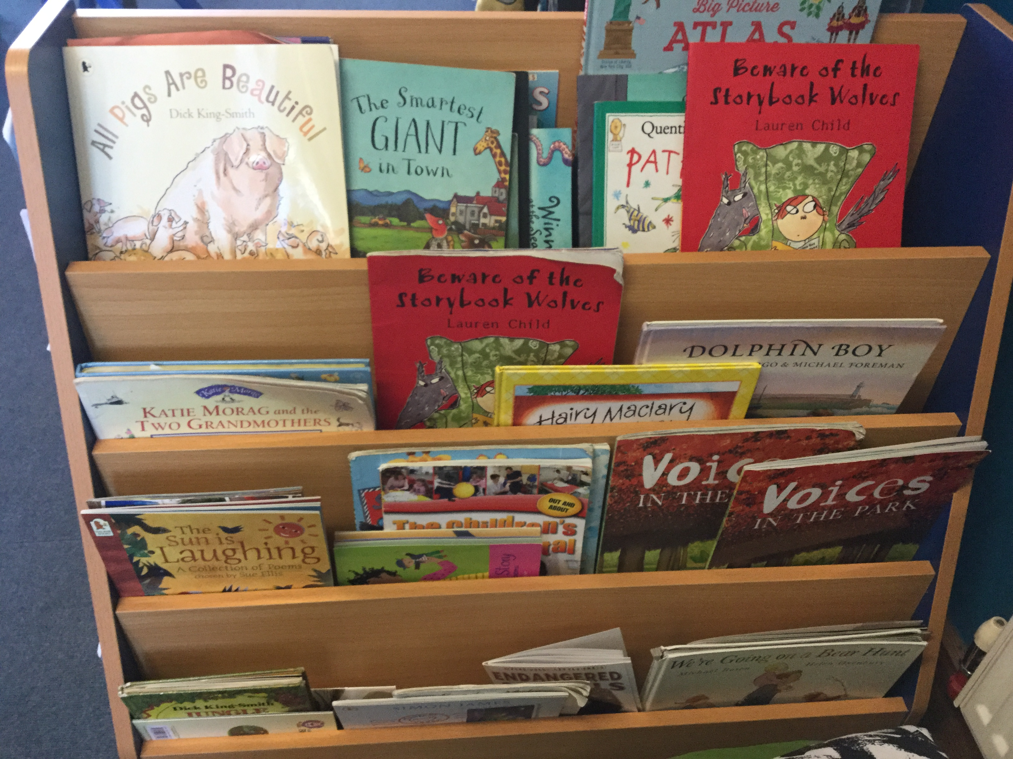
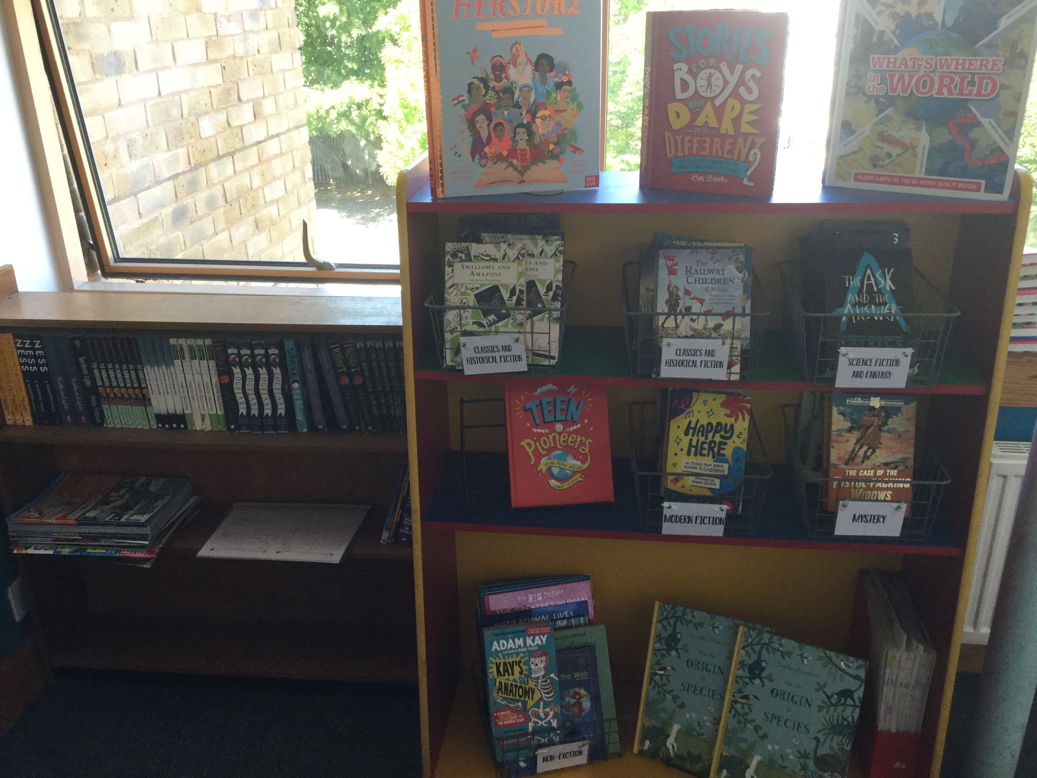
New bookshelves
Reading Quest
Protected reading aloud time
Time for book journaling and informal book talk
Promote and reward reading at home

Slide 15
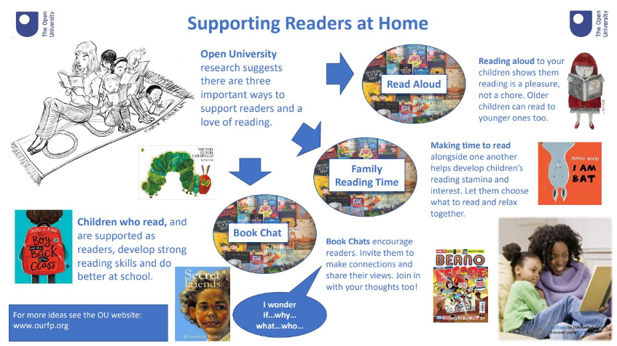

Slide 16

How families can support
Make reading visible; have books available in your home and let your child see you reading. Children need to see that reading is something adults do too.
Respect children’s reading choices. They may have their colour-banded book to read, but we also encourage them to read anything and everything that interests them.

Slide 17


How families can support
Visit the library and make use of free reading apps like Libby and BorrowBox
Re-read familiar and favourite books
Try to avoid making reading feel like a punishment or a chore

Slide 18
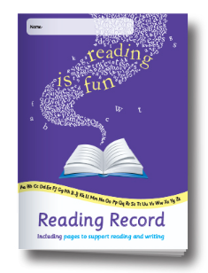
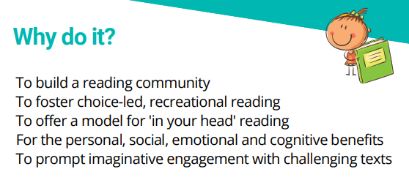
How families can support
Make time to listen to them read – even when they are fluent.
Talk to them about their reading, ask open-ended questions and make connections with children’s own lives and interests.
Read aloud to them.

Slide 19
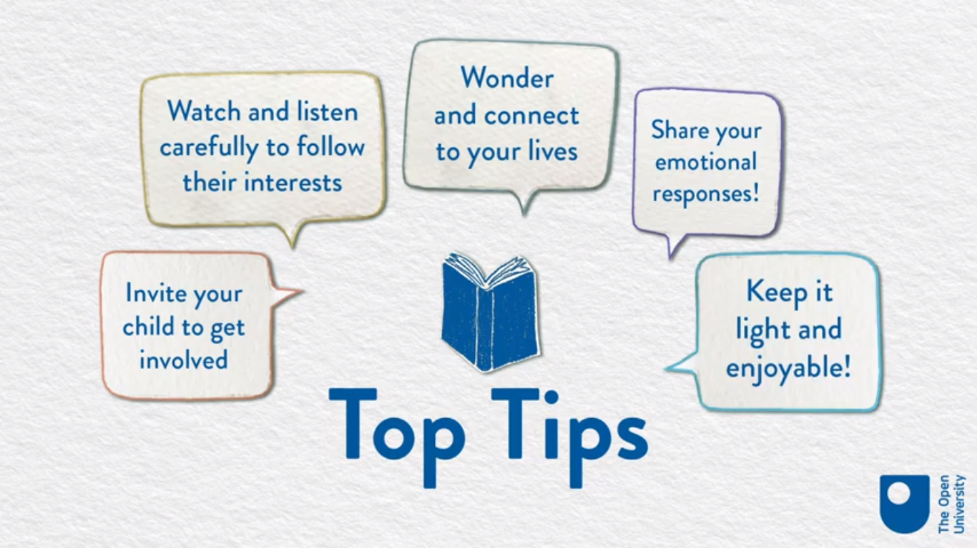
How families can support
Video

Slide 20

Year 2 children are expected to: | To support this, you could say:
Continue to apply phonic knowledge and skills as the route to decode words until automatic decoding has been embedded and is fluent | Can you sound it out? Which sounds do you know?
Read familiar words quickly without needing to sound them out | Can you find the word … quicker than me?
Read words containing common suffixes | Can you put your finger on a word that ends in the suffix –less?
Self correct when they have read a sentence incorrectly | Did that sentence make sense to you? Do you want to try it again?
Use a range of decoding strategies | How can we break the word into smaller chunks? What does the word look like? Can we think of any words inside it?
Retell a story, referring to most of the key events and characters | I’ve forgotten– what happens in that story again? What were the characters called? What happened after that?
Find the answer to questions in non-fiction, stories and poems | Which part of the text tells me about …? Can you find …?
Decide how useful a non-fiction text is for a particular purpose | If I wanted to learn about … would this be useful? Why?
Be aware that books are set in different times and places | Do you think this book was set whilst you were alive? What about whilst I was alive? Why?
Relate what they have read to their own experiences | Do you remember when we went to … and saw…? This story reminds me of that.
Continue to build up a repertoire of poems learnt by heart | Could you teach your little brother the words to Jack and Jill?
Recognise key themes and ideas within a text | So, it seems like this story says you should always be honest. Do you know any other stories about honesty?
Make simple inferences about thoughts and feelings of characters and reasons for their actions | What do you think … is feeling now? What might they do next? What makes you say that?

Slide 21
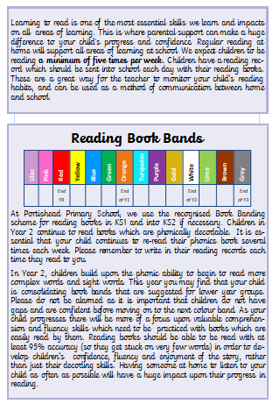
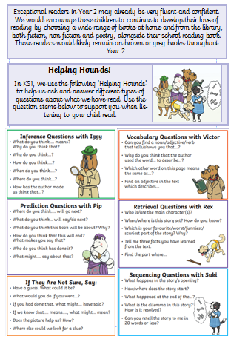

Slide 22

By Year 4, pupils should be able to independently, fluently and enthusiastically read books written at an age-appropriate interest level. They should be able to read them accurately and at a speed that allows them to focus on understanding what they have read, rather than on decoding individual words. They should be able to decode most new words outside of their spoken vocabulary, making a good attempt at the word’s pronunciation. As their decoding skills become secure, efforts should be made to introduce children to new words which will increase their vocabulary. This should be done through discussion and by introducing children to a wide range of texts, including stories, poems, plays and non-fiction pieces on a wide range of subjects. Children in Year 4 should be securing the skill of reading silently to themselves.
What This Means for Parents
Give your child access to lots of books on many different topics and by a wide range of authors who write in different styles, e.g. Michael Morpurgo, Philip Pullman, Lauren St John.
Encourage your child to attempt to pronounce new words they see in the environment around them. Discuss tricky parts and model the correct way.
Broaden the vocabulary you use when speaking to your child and be prepared to clarify the meaning of a wider range of words.
Encourage your child to read silently to themselves but check their understanding of what they have read after doing so.

Slide 23
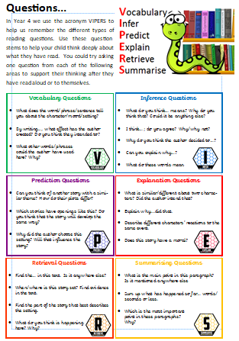
Why is it important to listen to your child read?
Parents often wonder how they can help to develop the reading skills of children who are already fluent readers. The best way is to continue to share books with your child, regularly listening to them read, sometimes reading to or with them, but also discussing books in increasing depth.
Learning to read is one of the most essential skills we learn and impacts on all areas of learning. This is where parental support can make a huge difference to your child's progress and confidence. Regular reading at home will support all areas of learning at school. We expect children to be reading a minimum of three times per week for 15 minutes at a time. Children are issued with a reading record which should be sent into school each day with their reading books. These are a great way for the teacher to monitor your child’s reading habits, and can be used as a method of communication between home and school.
How to help with your child’s reading in Year 4
Read longer stories/ novels and talk about them
When reading non-fiction, point out persuasive language, facts, opinions
Discuss points of view expressed in the text
Encourage your child to ask the meaning of more complex language regularly
Talk about the styles of individual writers
Talk about the place and time a story is set in.
Once children have developed the basic skills of reading, there can be a risk that their motivation and enthusiasm begins to lessen. This is a vital sign in children’s reading development and the point at which parents can offer invaluable support. Taking the time to talk to your children about the books they choose and listening to them reading aloud regularly can make all the difference. Children need to understand why we read. They need to experience the range of feelings that a book can create or the power that can be gained from accessing information.
Reading must not only be confined to stories. Many children love reading comics, magazines, newspapers, e-readers, information books and poetry. All of these reading activities should be encouraged.

